Slide 1


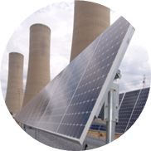
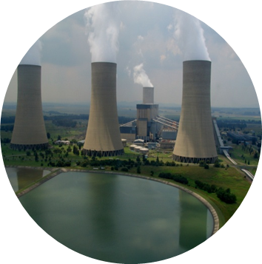
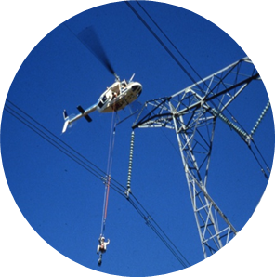
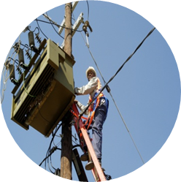
Diagnosis of Gassing Transformer using DGA
Presented by: Teboho Richard Lekeno
Date: 26 May 2020

Slide 2
Presentation Outline/Overview
1. What is dissolved gas analysis?
2. Faults and generate gases
3. DGA methods to be used
3.1. Key-gas method
3.2. Individual and total dissolved key-gas concentration method
3.3. Rogers ratio method
3.4. Duval triangle method
4. Transformer samples data
5. Transformer fault detection
5.1. Key-gas method
5.2. Individual and total dissolved key-gas concentration method
6. Transformer fault analysis
6.1. Rogers ratio method
6.2. Duval triangle method
7. Critical Analysis
8. Conclusion

Slide 3
Purpose
Dissolve Gas Analysis
Detect incipient faults
Supervise suspect transformers
Fault explanation
Assuring health of new transformers
Gas Name | Symbol
Hydrogen | H₂
Methane | CH₄
Ethylene | C₂H₄
Ethane | C₂H₆
Acetylene | C₂H₂
Carbon monoxide | CO
Carbon dioxide | CO₂
Nitrogen | N₂
Oxygen | O₂
Total dissolved combustible gases | All mentioned gases accept CO₂ & O₂
Working principle
Oil and cellulose
Decomposition gases generation
Normal (aging)
Abnormal (faults)

Slide 4
Key Gas Method
Detect presence of faults
Uses individual gases or key gases
Correlate DGA results with 4 sets of charts.

Slide 5
Individual and Total Dissolved Key-Gas Concentration Method
Used for detecting faults
Independent & assumes no previous tests made
Uses the highest level individual gas or TDCG
TDCG = condition 3 but a specific gas = condition 4 then transformer = condition 4
status | Operation
Condition 1 | Satisfactory (investigate excessive gases)
Condition 2 | Possible fault (investigate excessive gases)
Condition 3 | Excessive decomposition of cellulose/oil (take frequent samples for testing)
Condition 4 | Excessive decomposition of cellulose/oil (continuing operation may lead to failure)
status | H₂ | CH₄ | C₂H₂ | C₂H₄ | C₂H₆ | CO | CO₂ | TDCG
Condition 1 | 100 | 120 | 35 | 50 | 65 | 350 | 2500 | 720
Condition 2 | 101-700 | 121-400 | 36-50 | 51-100 | 66-100 | 351-570 | 2500-4000 | 721-1920
Condition 3 | 701-1800 | 401-1000 | 51-80 | 101-200 | 101-150 | 571-1400 | 4001-10000 | 1921-4630
Condition 4 | >1800 | 1000 | >80 | >200 | >150 | >1400 | >10000 | >4630

Slide 6
Rogers Ratio Method
Code Range of Ratios | C₂H₂/C₂H₄ | CH₄/H₂ | C₂H₄/C₂H₆ | Detection limits
 |  |  |  | x1 | x10 | gas
< 0.1 0.1-1 1-3 >3 | 0 1 1 2 | 1 0 2 2 | 0 0 1 2 | 1 ppm 10 ppm C₂H₂ 1 ppm 10 ppm C₂H₄ 1 ppm 10 ppm CH₄ 1 ppm 10 ppm C₂H₆ 5 ppm 50 ppm H₂
case | C₂H₂/C₂H₄ | CH₄/H₂ | C₂H₄/C₂H₆ | Suggested Fault Type
0 | 0 | 0 | 0 | No fault
1 | 1 | 1 | 0 | Low energy PD
2 | 1 | 1 | 0 | High energy PD
3 | 1-2 | 0 | 1-2 | Low energy arcing, sparking, discharge
4 | 1 | 0 | 2 | High energy discharge, arcing
5 | 0 | 0 | 1 | Thermal fault <150°C
6 | 0 | 2 | 0 | Thermal F 150-300°C
7 | 0 | 2 | 1 | Thermal F 300-700°C
8 | 0 | 2 | 2 | Thermal fault >700°C
Fault analyzing not fault detecting
Uses 3 ratios
Denominator = gas detection limit if gas (denominator) = 0
Derived from Doernenburg ratio method
Accuracy drops with gas used < 10x chromatograph can detect

Slide 7
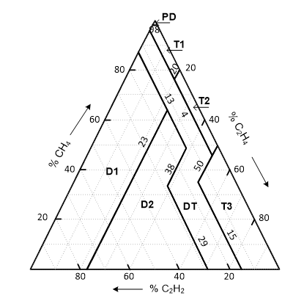
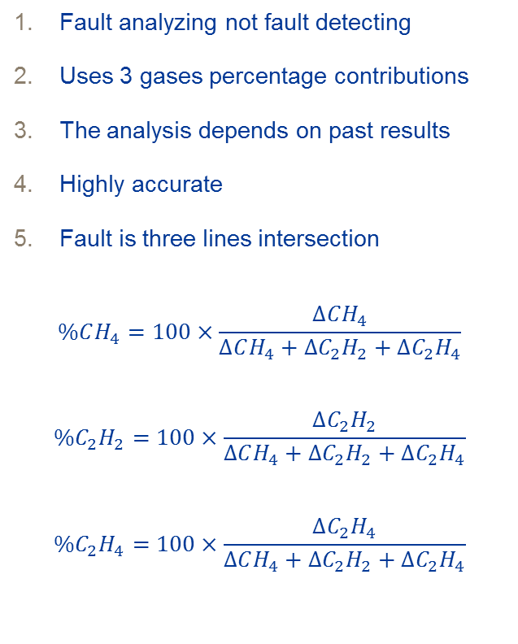
Duval Triangle Method
Fault analyzing not fault detecting
Uses 3 gases percentage contributions
The analysis depends on past results
Highly accurate
Fault is three lines intersection
$$\%CH_{4}=100×\frac{∆CH_{4}}{∆CH_{4}+{∆C}_{2}H_{2}+{∆C}_{2}H_{4}}$$
$$\%C_{2}H_{2}=100×\frac{{∆C}_{2}H_{2}}{∆CH_{4}+{∆C}_{2}H_{2}+{∆C}_{2}H_{4}}$$
$$\%C_{2}H_{4}=100×\frac{{∆C}_{2}H_{4}}{∆CH_{4}+{∆C}_{2}H_{2}+{∆C}_{2}H_{4}}$$
Zone | Fault Indication
T1 | Thermal fault ≤ 300°C
T2 | Thermal fault > 300°C, ≤ 700°C
T3 | Thermal fault > 700°C
D1 | Low energy discharge (sparking)
D2 | High energy discharge (Arcing)
DT | Combination of thermal and electrical faults
PD | Partial discharge

Slide 8
Duval Triangle Method Continue
Requirements to us the DTM
A problem with the transformer should exist
One of the hydrocarbons or hydrogen should on condition 3 or
At least one individual gas must be at L1 level or above
ABB (and the gas generation rate at G2)
Gas | L1 limit | G1 limits (ppm/month) | G2 limits (ppm/month)
H₂ | 100 | 10 | 50
CH₄ | 75 | 8 | 38
C₂H₂ | 3 | 3 | 3
C₂H₄ | 75 | 8 | 38
C₂H₆ | 75 | 8 | 38
CO | 700 | 70 | 350
CO₂ | 7000 | 700 | 3500
method | % correct diagnosis | % unresolved diagnosis | % wrong diagnosis
KGM | 42 | 0 | 58
RRM | 62 | 33 | 5
DTM | 96 | 0 | 4

Slide 9
Transformer Samples Data
Sample date | H₂ | O₂ | N₂ | CH₄ | CO | CO₂ | C₂H₆ | C₂H₄ | C₂H₂ | Moisture reading
2013/11/07 | 84 | 9003 | 55661 | 26 | 86 | 136 | 51 | 11 | 0 | 1
2014/05/06 | 93 | 3014 | 43697 | 42 | 107 | 86 | 82 | 17 | 0 | 7
2014/11/04 | 75 | 2247 | 41555 | 49 | 119 | 389 | 96 | 20 | 0 | 3
2015/05/05 | 65 | 2801 | 49238 | 81 | 120 | 528 | 127 | 44 | 0 | 5
2015/11/04 | 49 | 2687 | 49813 | 100 | 123 | 618 | 146 | 62 | 0 | 5
2016/05/05 | 41 | 2560 | 54990 | 128 | 132 | 528 | 193 | 80 | 0 | 4
2016/11/02 | 42 | 2251 | 52823 | 135 | 128 | 625 | 188 | 90 | 0 | 7
2017/05/04 | 28 | 4576 | 57925 | 140 | 118 | 522 | 228 | 94 | 0 | 11
2017/11/01 | 35 | 3197 | 59794 | 177 | 175 | 754 | 243 | 104 | 0 | 8
2018/05/03 | 35 | 2593 | 58770 | 201 | 162 | 301 | 286 | 136 | 0 | 4

Slide 10
Fault Detection Using Key-Gas Method

Slide 11
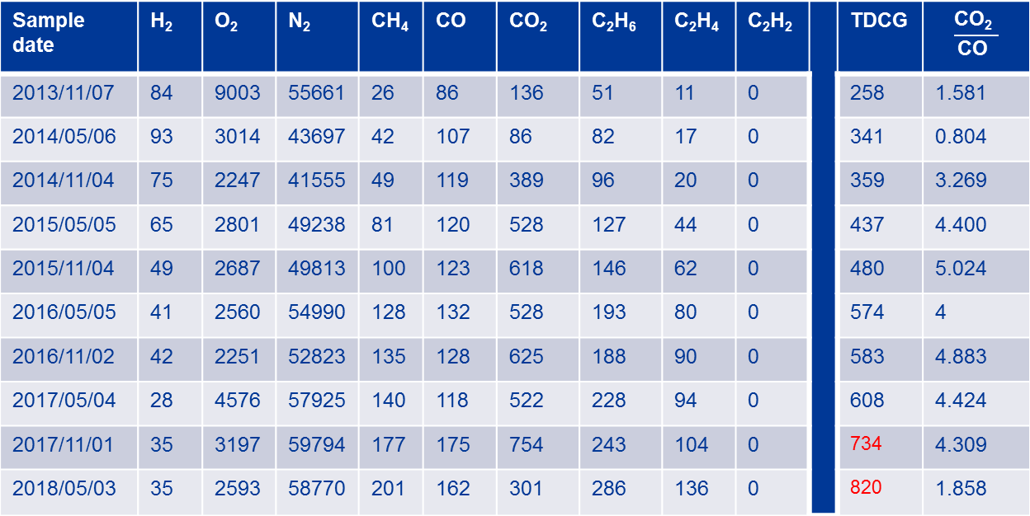
Fault Detection Using Individual & Total Dissolved Key-Gas Concentration Method
Sample date | H₂ | O₂ | N₂ | CH₄ | CO | CO₂ | C₂H₆ | C₂H₄ | C₂H₂ |  | TDCG | $$\frac{\text{C}\text{O}\text{2} }{\text{C}\text{O} }$$
2013/11/07 | 84 | 9003 | 55661 | 26 | 86 | 136 | 51 | 11 | 0 |  | 258 | 1.581
2014/05/06 | 93 | 3014 | 43697 | 42 | 107 | 86 | 82 | 17 | 0 |  | 341 | 0.804
2014/11/04 | 75 | 2247 | 41555 | 49 | 119 | 389 | 96 | 20 | 0 |  | 359 | 3.269
2015/05/05 | 65 | 2801 | 49238 | 81 | 120 | 528 | 127 | 44 | 0 |  | 437 | 4.400
2015/11/04 | 49 | 2687 | 49813 | 100 | 123 | 618 | 146 | 62 | 0 |  | 480 | 5.024
2016/05/05 | 41 | 2560 | 54990 | 128 | 132 | 528 | 193 | 80 | 0 |  | 574 | 4
2016/11/02 | 42 | 2251 | 52823 | 135 | 128 | 625 | 188 | 90 | 0 |  | 583 | 4.883
2017/05/04 | 28 | 4576 | 57925 | 140 | 118 | 522 | 228 | 94 | 0 |  | 608 | 4.424
2017/11/01 | 35 | 3197 | 59794 | 177 | 175 | 754 | 243 | 104 | 0 |  | 734 | 4.309
2018/05/03 | 35 | 2593 | 58770 | 201 | 162 | 301 | 286 | 136 | 0 |  | 820 | 1.858

Slide 12
Fault Detection Using Individual & Total Dissolved Key-Gas Concentration Method Continue
Sample date | Status
2013/11/07 | Condition 1: Operating satisfactorily
2014/05/06 | Condition 1: Operating satisfactorily (C2H6 should be investigated, exceed limits)
2014/11/04 | Condition 1: Operating satisfactorily (C2H6 should be investigated, exceed limits)
2015/05/05 | Condition 1: Operating satisfactorily (C2H6 should be investigated, exceed limits)
2015/11/04 | Condition 1: Operating satisfactorily (C2H6 & C2H4 should be investigated, exceed limits)
2016/05/05 | Condition 1: Operating satisfactorily (C2H6 & C2H4 should be investigated, exceed limits)
2016/11/02 | Condition 1: Operating satisfactorily (C2H6 & C2H4 should be investigated, exceed limits)
2017/05/04 | Condition 1: Operating satisfactorily (C2H6 & C2H4 should be investigated, exceed limits)
2017/11/01 | Condition 2: A fault may be present (C2H6 & C2H4 should be investigated, exceed limits)
2018/05/03 | Condition 2: A fault may be present (C2H6 & C2H4 should be investigated, exceed limits)

Slide 13
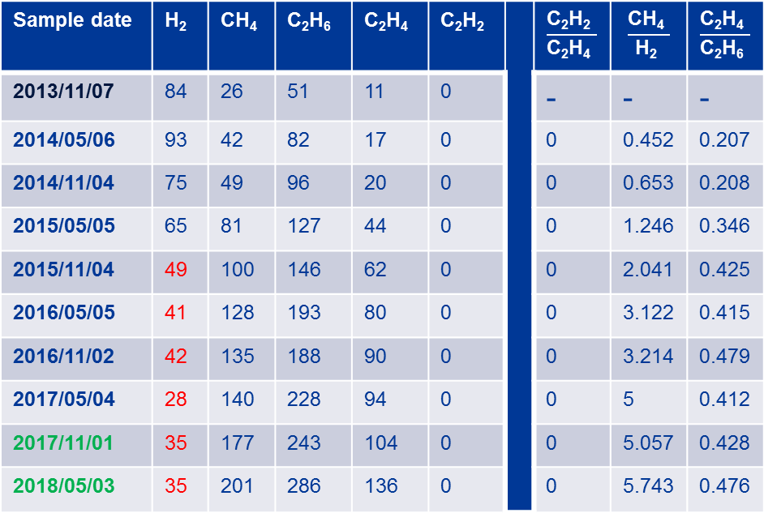
Fault Analysis Using Rogers Ratio Method
Sample date | H₂ | CH₄ | C₂H₆ | C₂H₄ | C₂H₂ |  | $$\frac{\text{C}\text{2}\text{H}\text{2} }{\text{C}\text{2}\text{H}\text{4} }$$ | $$\frac{\text{CH}\text{4} }{\text{H}\text{2} }$$ | $$\frac{\text{C}\text{2}\text{H}\text{4} }{\text{C}\text{2}\text{H}\text{6} }$$
2013/11/07 | 84 | 26 | 51 | 11 | 0 |  | - | - | -
2014/05/06 | 93 | 42 | 82 | 17 | 0 |  | 0 | 0.452 | 0.207
2014/11/04 | 75 | 49 | 96 | 20 | 0 |  | 0 | 0.653 | 0.208
2015/05/05 | 65 | 81 | 127 | 44 | 0 |  | 0 | 1.246 | 0.346
2015/11/04 | 49 | 100 | 146 | 62 | 0 |  | 0 | 2.041 | 0.425
2016/05/05 | 41 | 128 | 193 | 80 | 0 |  | 0 | 3.122 | 0.415
2016/11/02 | 42 | 135 | 188 | 90 | 0 |  | 0 | 3.214 | 0.479
2017/05/04 | 28 | 140 | 228 | 94 | 0 |  | 0 | 5 | 0.412
2017/11/01 | 35 | 177 | 243 | 104 | 0 |  | 0 | 5.057 | 0.428
2018/05/03 | 35 | 201 | 286 | 136 | 0 |  | 0 | 5.743 | 0.476

Slide 14
Fault Analysis Using Rogers Ratio Method Continue
Sample date | H₂ | CH₄ | C₂H₆ | C₂H₄ | C₂H₂ |  | Fault Type | Problem found
2013/11/07 | 84 | 26 | 51 | 11 | 0 |  | - | -
2014/05/06 | 93 | 42 | 82 | 17 | 0 |  | No fault | -
2014/11/04 | 75 | 49 | 96 | 20 | 0 |  | No fault | -
2015/05/05 | 65 | 81 | 127 | 44 | 0 |  | Thermal F 150-300°C | -This issue could be stray flux in the tank. -overheating of copper conductor from eddy current -This issue involves cellulose insulation, which will produce CO and CO₂
2015/11/04 | 49 | 100 | 146 | 62 | 0 |  | Thermal F 150-300°C
2016/05/05 | 41 | 128 | 193 | 80 | 0 |  | Thermal F 150-300°C
2016/11/02 | 42 | 135 | 188 | 90 | 0 |  | Thermal F 150-300°C
2017/05/04 | 28 | 140 | 228 | 94 | 0 |  | Thermal F 150-300°C
2017/11/01 | 35 | 177 | 243 | 104 | 0 |  | Thermal F 150-300°C
2018/05/03 | 35 | 201 | 286 | 136 | 0 |  | Thermal F 150-300°C

Slide 15
Fault Analysis Using Duval Triangle Method
Sample date | CH₄ | C₂H₆ | C₂H₄ | C₂H₂ |  | ∆CH₄ | ∆C₂H₄ | ∆C₂H₂ | %CH₄ | %C₂H₄ | %C₂H₂
2013/11/07 | 26 | 51 | 11 | 0 |  | - | - | - | - | - | -
2014/05/06 | 42 | 82 | 17 | 0 |  | - | - | - | - | - | -
2014/11/04 | 49 | 96 | 20 | 0 |  | 7 | 3 | 0 | 70 | 30 | 0
2015/05/05 | 81 | 127 | 44 | 0 |  | 32 | 24 | 0 | 57.14 | 42.86 | 0
2015/11/04 | 100 | 146 | 62 | 0 |  | 19 | 18 | 0 | 51.35 | 48.65 | 0
2016/05/05 | 128 | 193 | 80 | 0 |  | 28 | 18 | 0 | 60.87 | 39.13 | 0
2016/11/02 | 135 | 188 | 90 | 0 |  | 7 | 10 | 0 | 41.18 | 58.82 | 0
2017/05/04 | 140 | 228 | 94 | 0 |  | 5 | 4 | 0 | 55.56 | 44.44 | 0
2017/11/01 | 177 | 243 | 104 | 0 |  | 37 | 10 | 0 | 78.72 | 21.28 | 0
2018/05/03 | 201 | 286 | 136 | 0 |  | 24 | 32 | 0 | 42.86 | 57.14 | 0

Slide 16
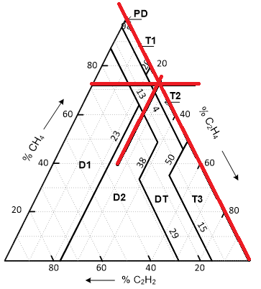
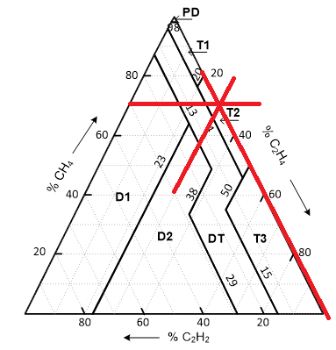
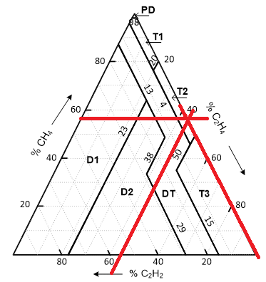
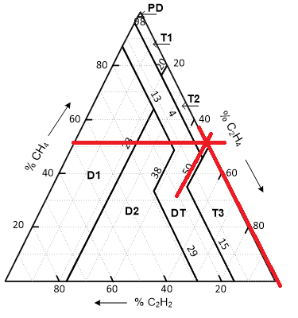
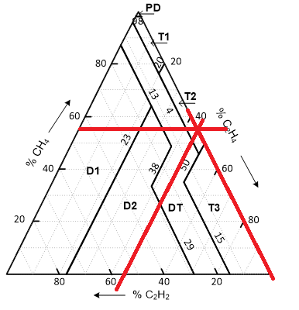
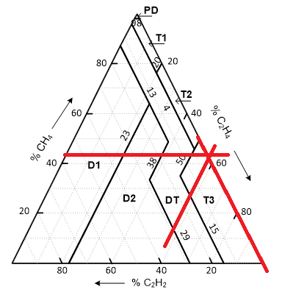
Fault Analysis Using Duval Triangle Method Continue

Slide 17
Fault Analysis Using Duval Triangle Method Continue
Sample date | CH₄ | C₂H₆ | C₂H₄ | C₂H₂ |  | Fault level
2013/11/07 | 26 | 51 | 11 | 0
2014/05/06 | 42 | 82 | 17 | 0
2014/11/04 | 49 | 96 | 20 | 0 |  | T2: thermal fault > 300°C, ≤ 700°C
2015/05/05 | 81 | 127 | 44 | 0 |  | T2: thermal fault > 300°C, ≤ 700°C
2015/11/04 | 100 | 146 | 62 | 0 |  | T2: thermal fault > 300°C, ≤ 700°C
2016/05/05 | 128 | 193 | 80 | 0 |  | T2: thermal fault > 300°C, ≤ 700°C
2016/11/02 | 135 | 188 | 90 | 0 |  | T3: thermal fault > 700°C
2017/05/04 | 140 | 228 | 94 | 0 |  | T2: thermal fault > 300°C, ≤ 700°C
2017/11/01 | 177 | 243 | 104 | 0 |  | T2: thermal fault > 300°C, ≤ 700°C
2018/05/03 | 201 | 286 | 136 | 0 |  | T3: thermal fault > 700°C

Slide 18
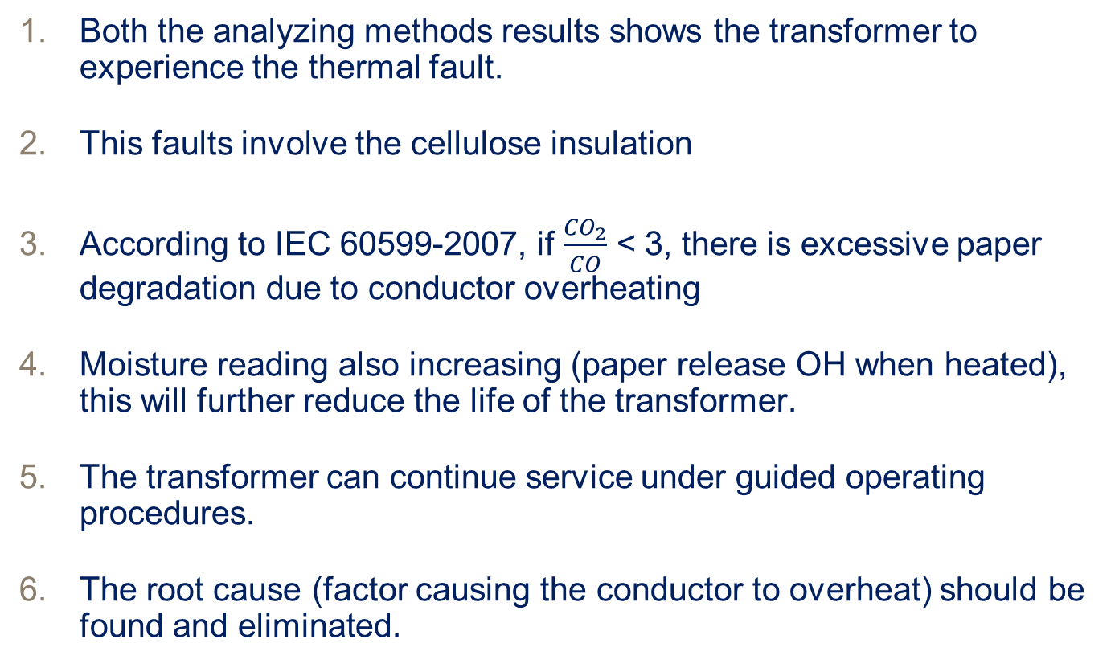
Critical Analysis of Results
Both the analyzing methods results shows the transformer to experience the thermal fault.
This faults involve the cellulose insulation
According to IEC 60599-2007, if $\frac{{CO}_{2}}{CO}$ < 3, there is excessive paper degradation due to conductor overheating
Moisture reading also increasing (paper release OH when heated), this will further reduce the life of the transformer.
The transformer can continue service under guided operating procedures.
The root cause (factor causing the conductor to overheat) should be found and eliminated.

Slide 19
Conclusion
Different DGA method for detecting and analyzing transformer faults for presented.
The gassing transformer data was presented and DGA analysis was used to identify the problem.
Both the analyzing method (RRM & DTM) results showed the thermal fault to be occurring inside the transformer.
The transformer can continue with service and root cause should be eliminated

